Slide 1
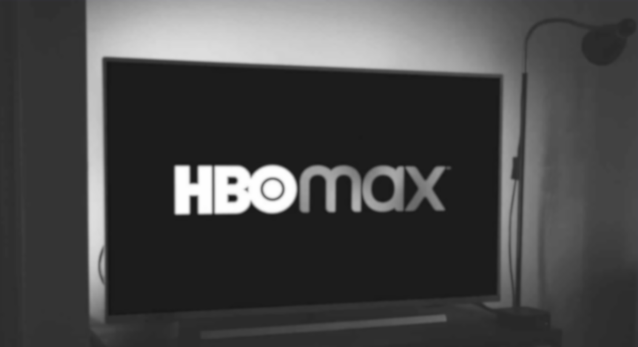

NLP Subreddit Classification for Sentiment Analysis
r/HBO vs r/Netflix

Slide 2
Agenda
01
02
03
04
Background
Workflow
Problem Statement
Data Cleaning
05
06
Exploratory Data Analysis
Modeling
07
08
Limitations
Recommendations & Conclusion

Slide 3

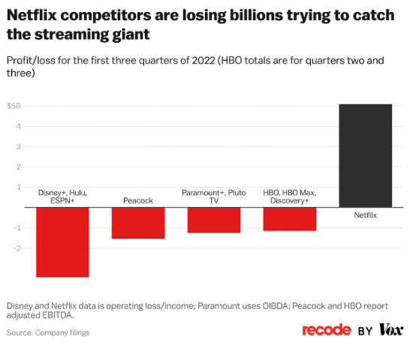
Background
HBO has lost billions of dollars in an effort to play catch up to its main rival

Slide 4
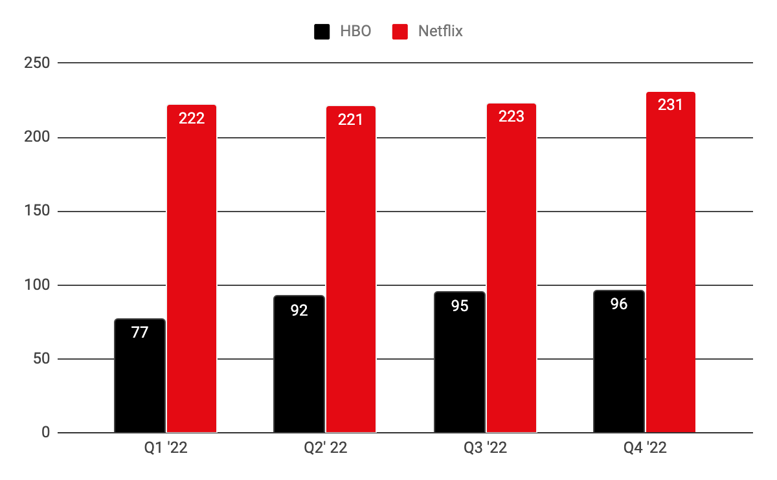
Subscribers (in millions)
Why is this happening?
Background
Over-reliance on its traditional cable TV model
Significant investments in developing streaming platform and producing original content

Slide 5

What can be done?
Audience
Targeting
Content
Development
Competitor
Analysis
Sentiment
Analysis
Gain insights on viewer preferences and tailor marketing campaigns accordingly
Identify emerging trends and topics
Identify areas of differentiation and competitive advantage
Enhance its offerings and strengthen relationship with audience

Slide 6
Problem Statement
As part of the Data team at HBO, this project aims to build a machine learning model to classify subreddits based on their content to identify topics that generate the most engagement and discussion among viewers. These insights will help the company make more informed decisions about its content development, marketing, and overall strategy.

Slide 7
Workflow
Web Scraping
Data Cleaning
Exploratory Data Analysis
Modeling
Hyperparameter tuning

Slide 8
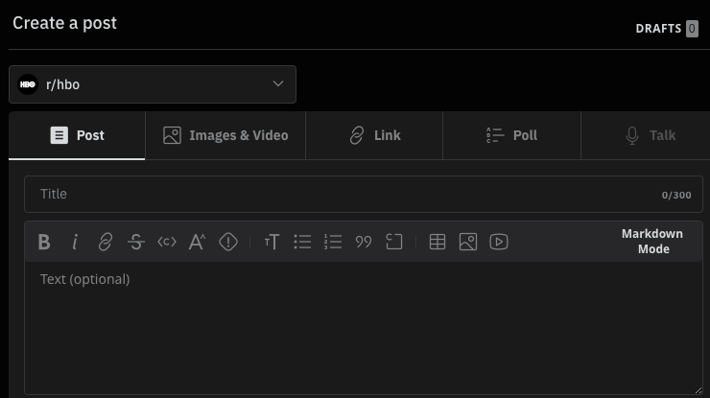
Mission statement
Web Scraping using Pushshift API
subreddit
1,000 posts retrieved per subreddit
3 columns
title
selftext

Slide 9

Remove the following:
Data Cleaning
Null / duplicate values
[removed] and [deleted] values
Punctuation
HTML text
Non-English text
Non-alphanumeric characters
Stopwords
Tokenisation
Lemmatisation

Slide 10
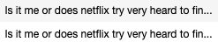
Examples removing...
Non-alphanumeric chars
HTML text
[removed] values
Punctuation
Duplicates

Slide 11


Tokenisation & Lemmatisation
tokenisation
lemmatisation

Slide 12
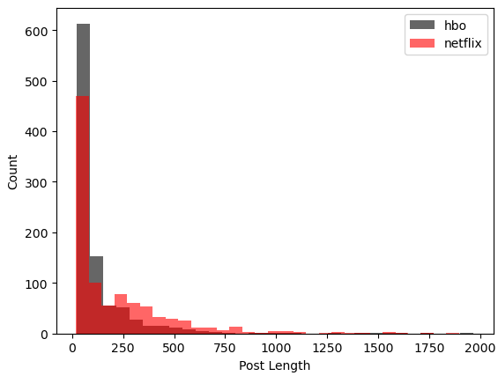
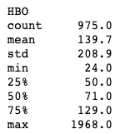
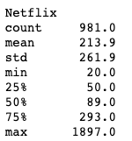
Exploratory Data Analysis
9 posts greater than 2,000 were removed as it was deemed irrelevant and could potentially skew our model
Netflix has greater post lengths overall

Slide 13
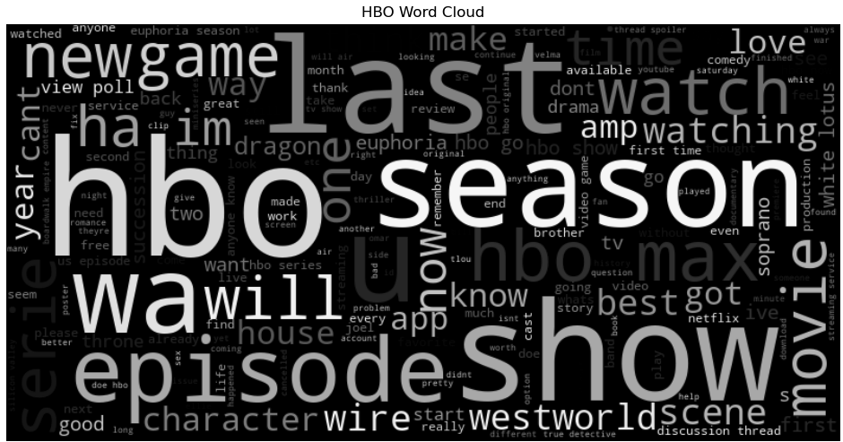
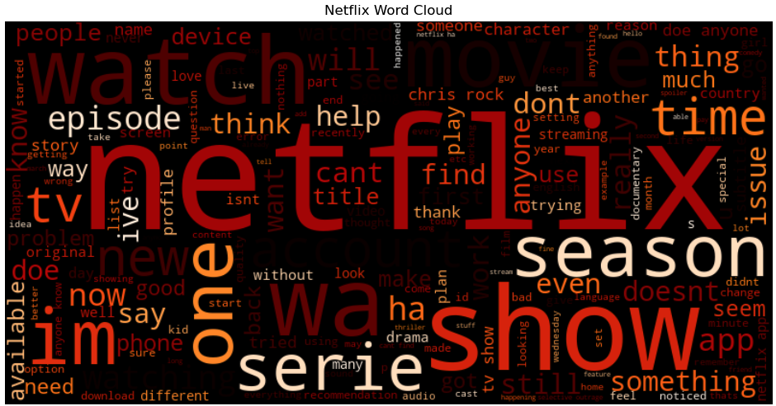
Exploratory Data Analysis
WordClouds were utilised to check for commonly occurring words to add to our Stopwords
For example, ‘view poll’ was dropped as these are common among “poll” Reddit posts

Slide 14
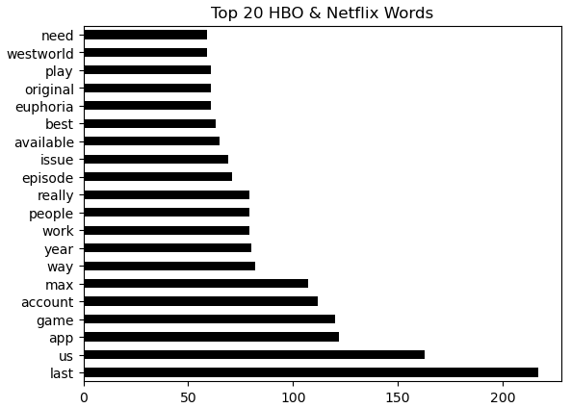
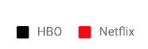
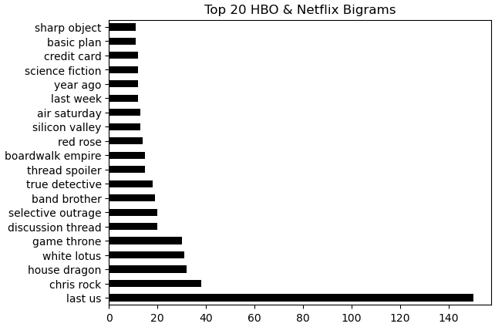
Exploratory Data Analysis
Interestingly, most of the keywords spotted relate to HBO
There seems to be many non-content related keywords that appear here
HBO has 11 shows mentioned that rivals Netflix’s 3

Slide 15
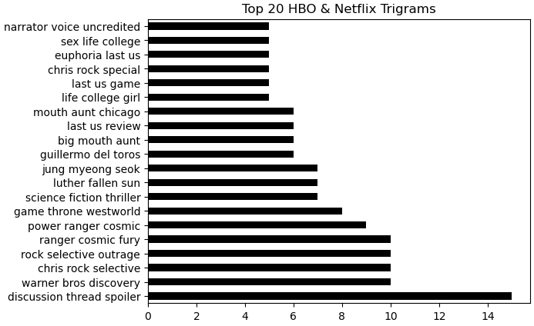
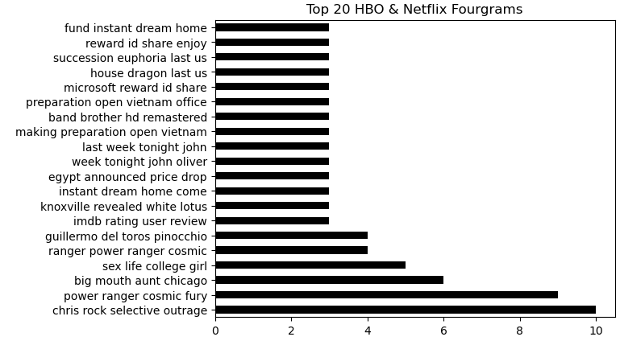
Exploratory Data Analysis
Netflix has 9 show mentions to HBO’s 8
However, number of keyword occurrences here are not as significant

Slide 16
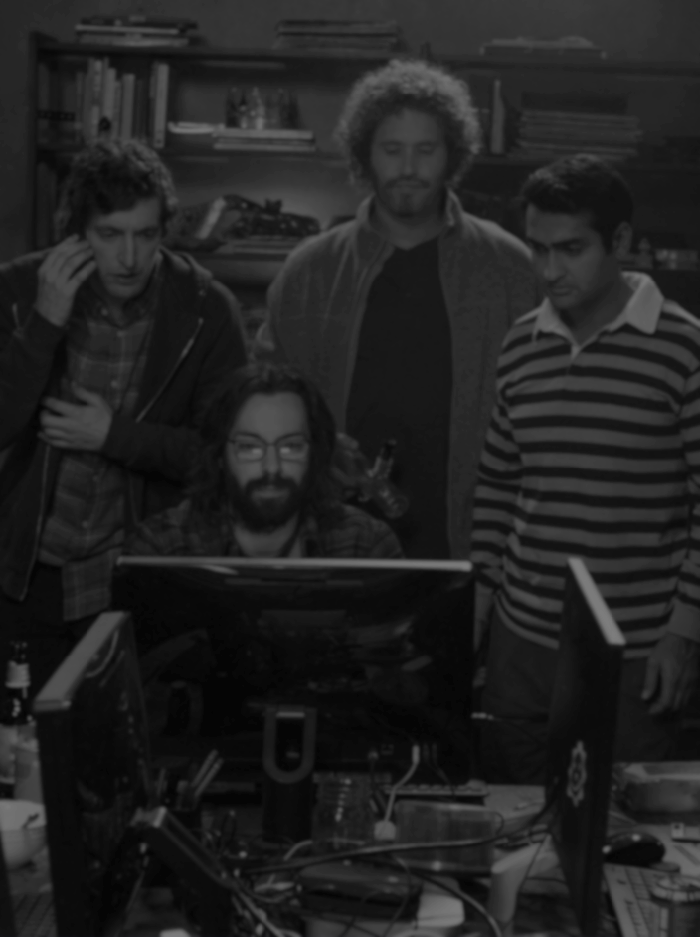

Modeling
Preprocessing /
Data Cleaning
Classification
Model Selection
Model Optimisation
CountVectorizer
TF-IDF Vectorizer
Multinomial Naïve Bayes
Logistic Regression
Random Forest
Gradient Boosting
Linear SVC
Hyperparameter Tuning

Slide 17


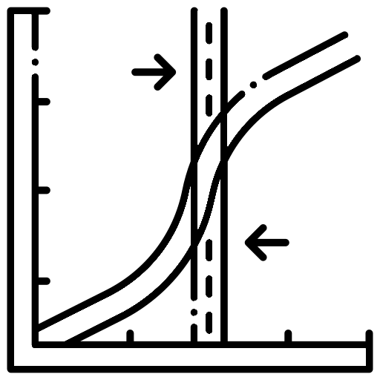

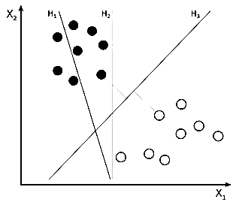
Modeling – Overview
Multinomial Naïve Bayes
Logistic Regression
Random Forest
Gradient Boosting
Linear SVC

Slide 18
Model Results (in %)
Before Tuning
After Tuning
Vector / Model | Train Accuracy | Test Accuracy | Train Accuracy | Test Accuracy
Multinomial Naïve Bayes CV | 94.8 | 78.4 | 99.6 | 80.3
Multinomial Naïve Bayes TF-IDF | 95.7 | 80.2 | 99.9 | 81.8
Logistic Regression CV | 99.3 | 77.6 | 99.0 | 79.9
Logistic Regression TF-IDF | 96.4 | 78.0 | 99.9 | 81.1
Random Forest CV | 99.3 | 75.7 | 84.9 | 75.6
Random Forest TF-IDF | 99.9 | 76.9 | 83.1 | 73.2
Gradient Boosting CV | 81.5 | 75.1 | 89.5 | 76.0
Gradient Boosting TF-IDF | 83.2 | 75.5 | 89.1 | 73.4
Linear SVC CV | 99.9 | 75.1 | 92.0 | 77.0
Linear SVC TF-IDF | 99.8 | 78.0 | 99.9 | 80.9

Slide 19
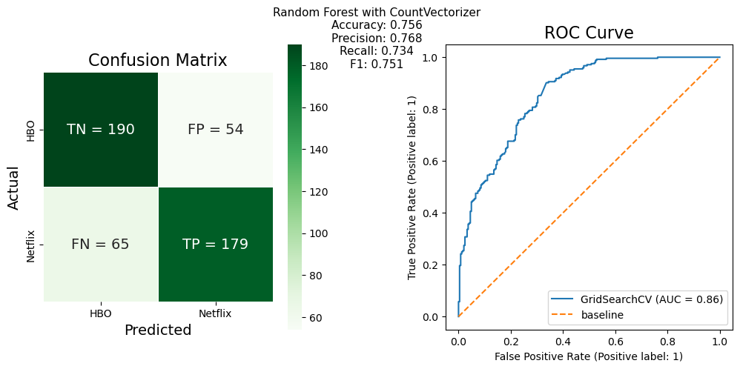
76% of predictions are correctly labeled
Accuracy
76 %
Wrongly labeled as HBO
13%
Wrongly labeled as Netflix
11%

Slide 20


Limitations
Limited training data
Limited resources
Sentiment Analysis
Inherent Variability
More data is required to train the model
(eg. lingo/ acronyms)
May require significant computing power with larger datasets
Current model may have too many features to focus on what is pertinent
Variability of random forest model can lead to different results each time model is run

Slide 21

Recommendations & Conclusion
The Last of Us, House of the Dragon and White Lotus were the most popular shows among HBO fans in the past year
Continue finetuning model to identify more aspects of shows which resonate most with fans
Gather more data to train the model and gauge overall sentiment
Consider scraping sites like RottenTomatoes and Metacritic where greater focus is on sentiment analysis and review classification
HBO’s consistent YoY increase in revenue, subscriber numbers and market share is a healthy sign that it should continue to focus on quality over quantity to cater to its ardent fanbase

Slide 22

Thank you
All images taken from HBO

